Slide 1
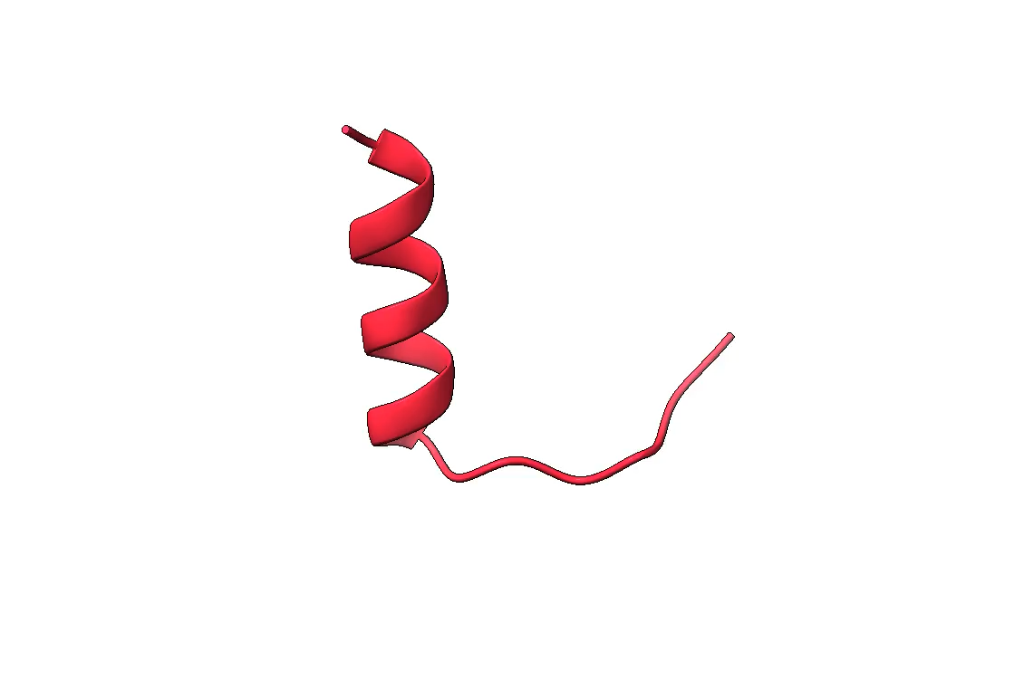
Molecular Detective Work
How the dances of proteins reveal complex personalities
Yousuf O. Ramahi
INSPIRE 2025
yousuf.ramahi@mail.utoronto.ca

Slide 2
Proteins are life’s molecular machines.
Illustration of the Cytoplasm, David Goodsell

Slide 3
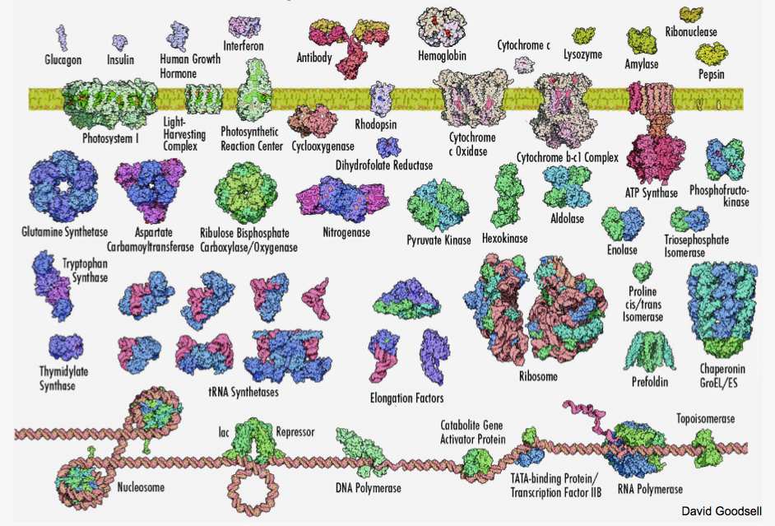
Proteins are a diverse set of molecules, structurally and functionally

Slide 4
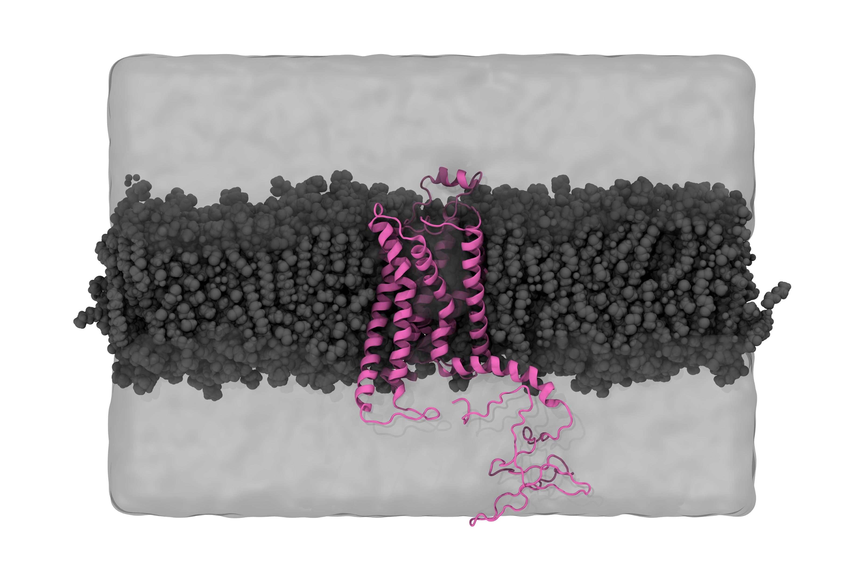
The adenosine A_{2A} receptor is a protein that I am studying.

Slide 5
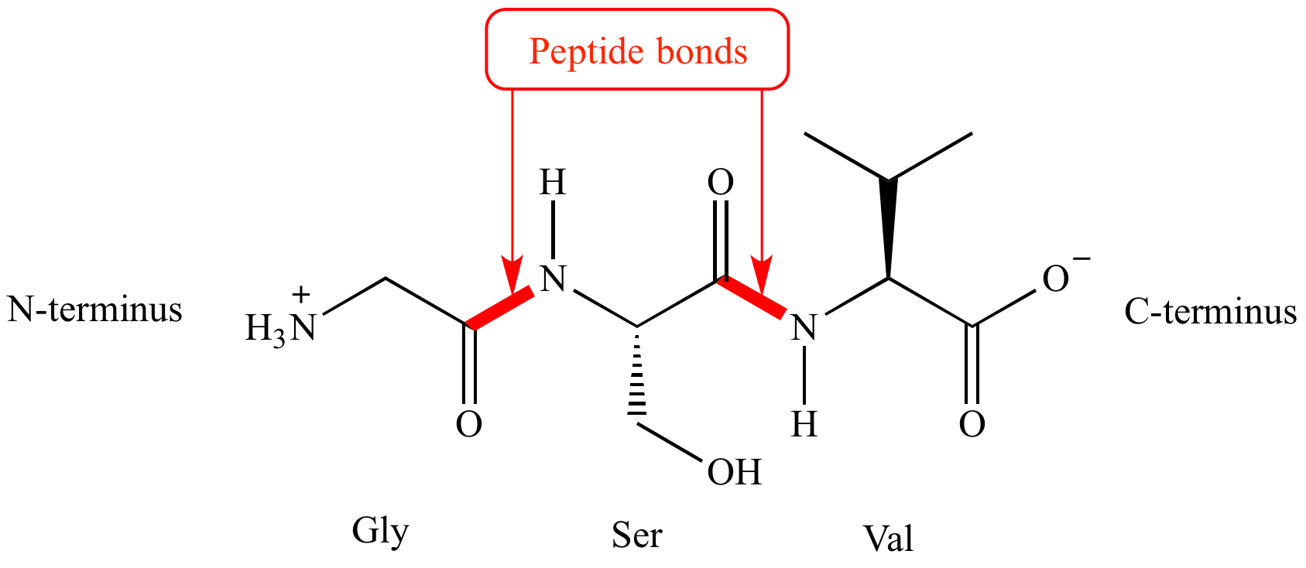
Amino acids are the Lego blocks that are snapped together to build polypeptides (proteins)

Slide 6
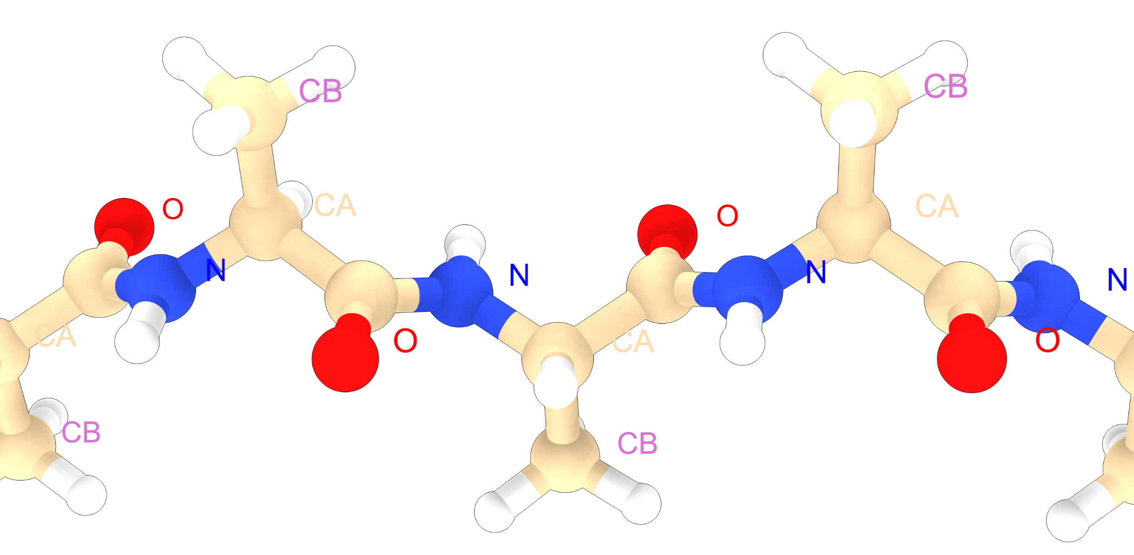
Amino acids are the Lego blocks that are snapped together to build polypeptides (proteins)

Slide 7
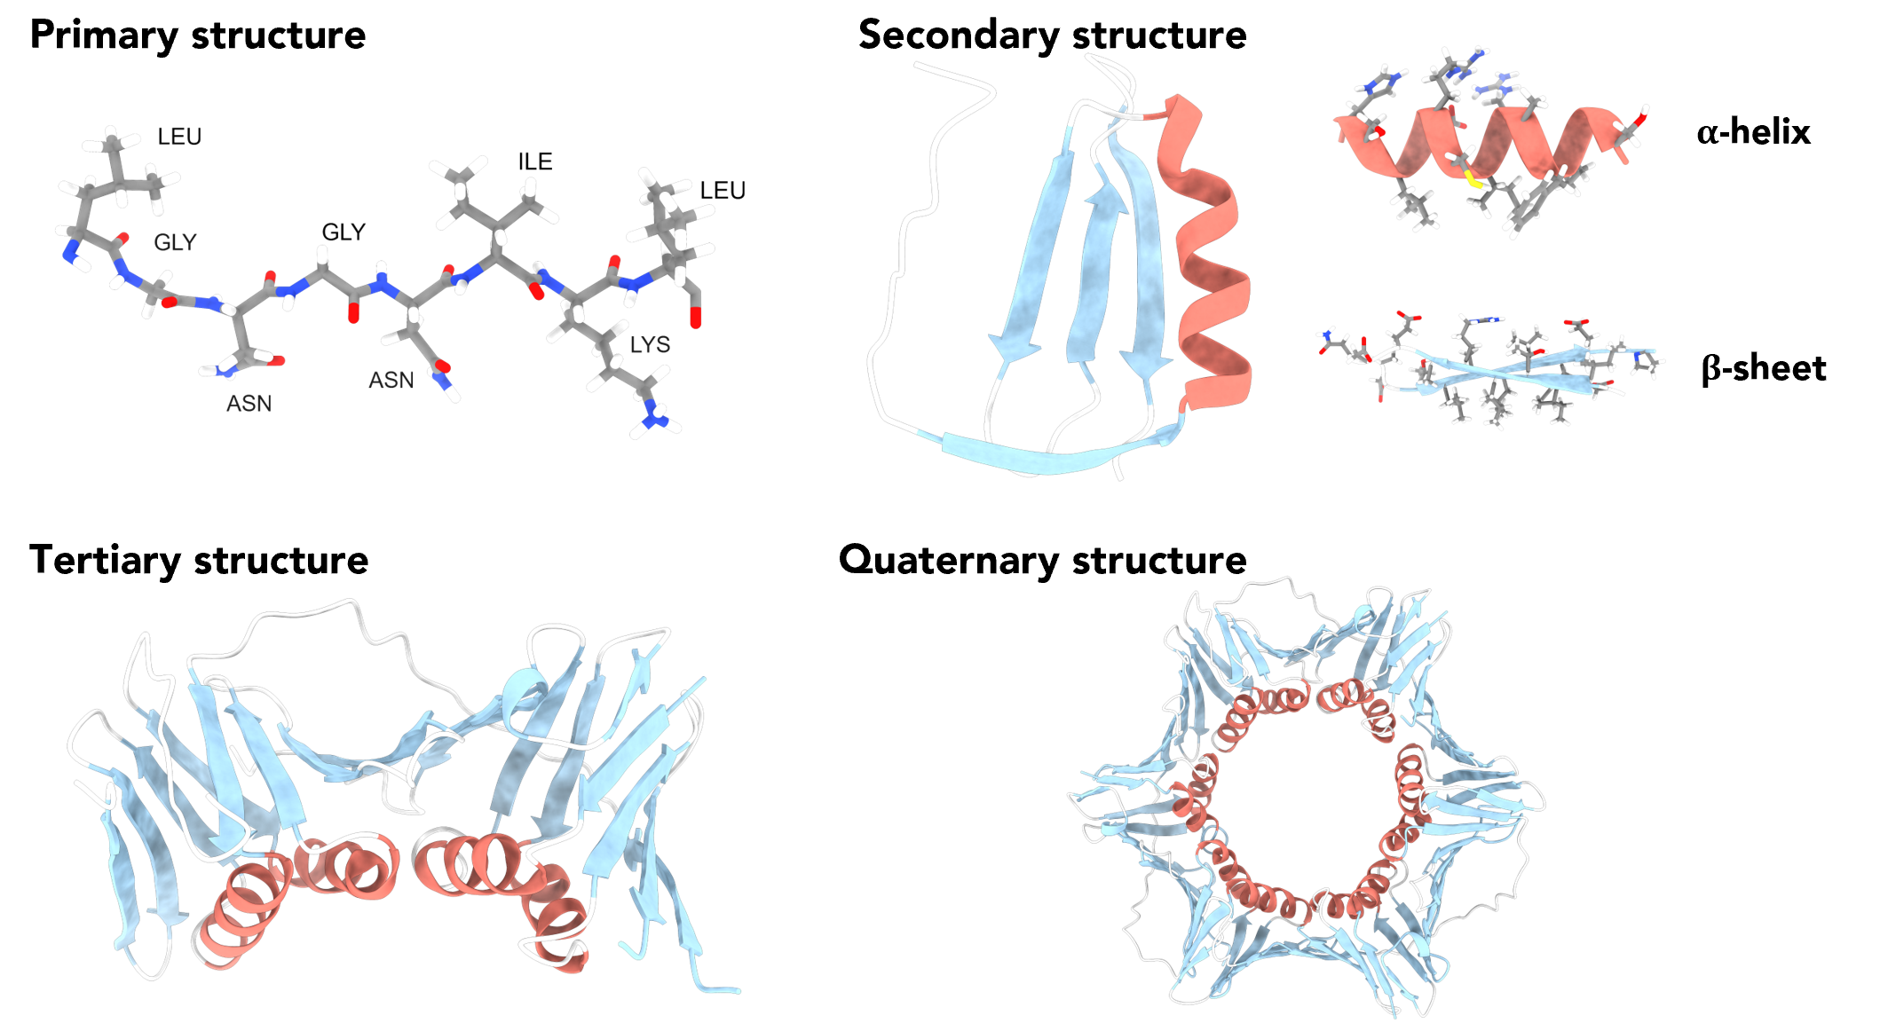
We choose to visually represent the parts of the protein that are most useful to us

Slide 8
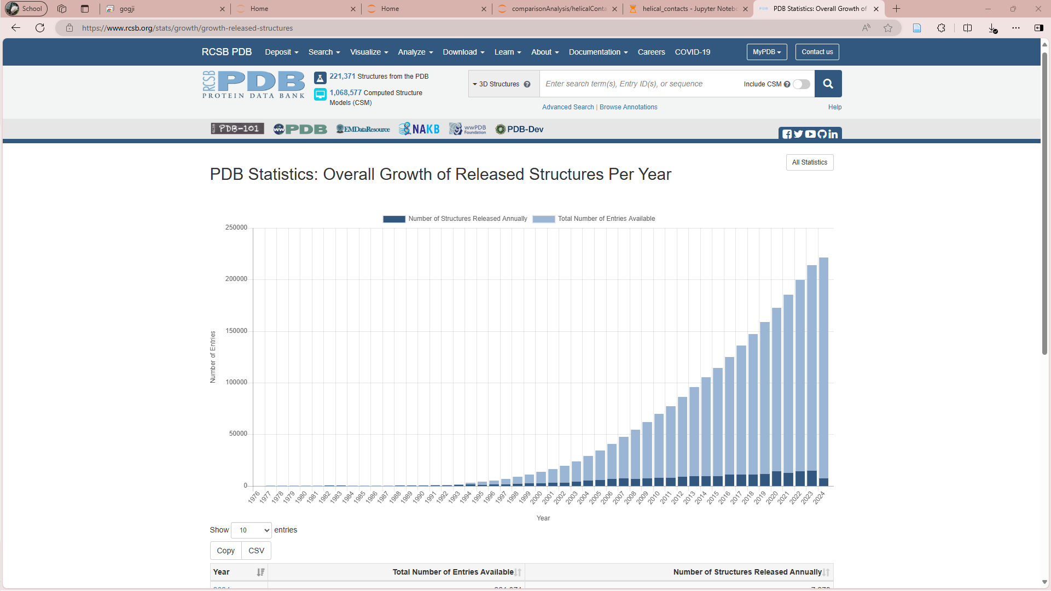
> 221’000 protein structures in the Protein Data Bank (PDB)
Notes:
- Screenshot captured in June 2024

Slide 9
How do proteins fold into such complex and stable structures?

Slide 10
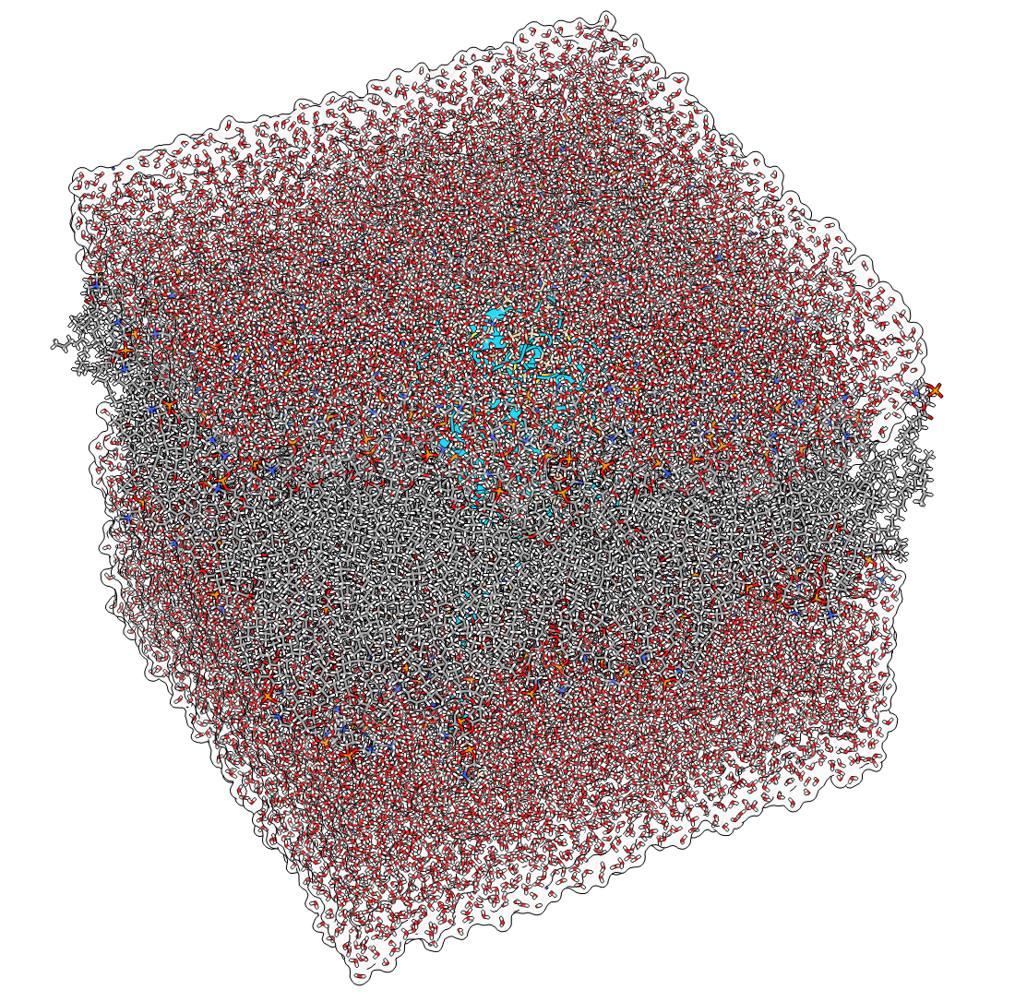
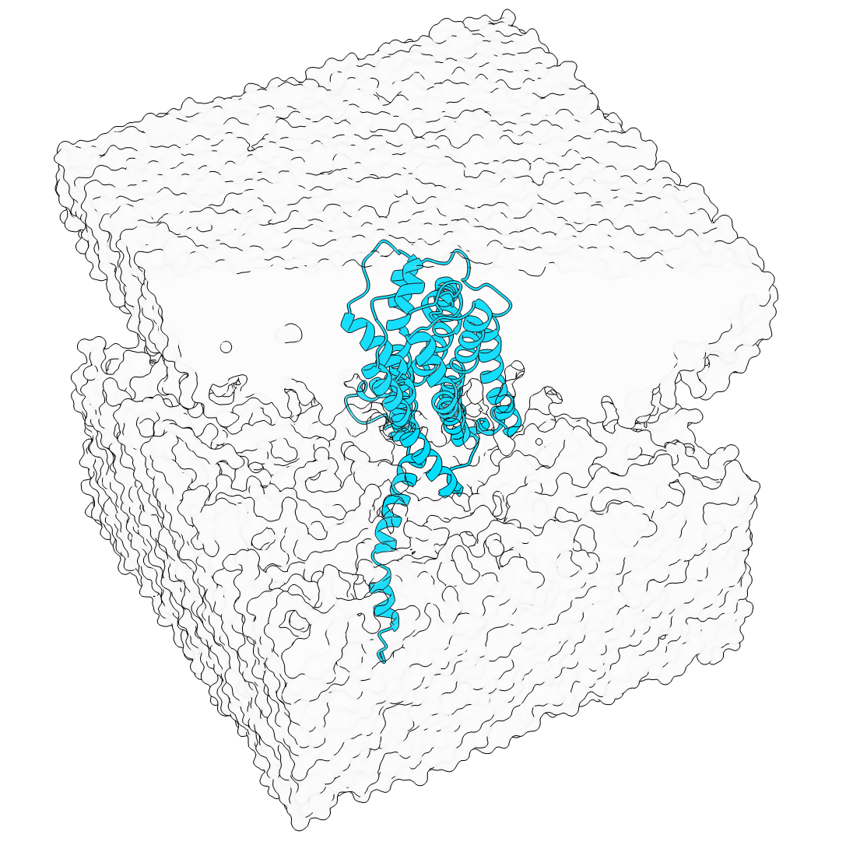
We can study protein folding and dynamics by simulating all the atoms
A_{2A} embedded in a lipid bilayer and solvated with water molecules.

Slide 11
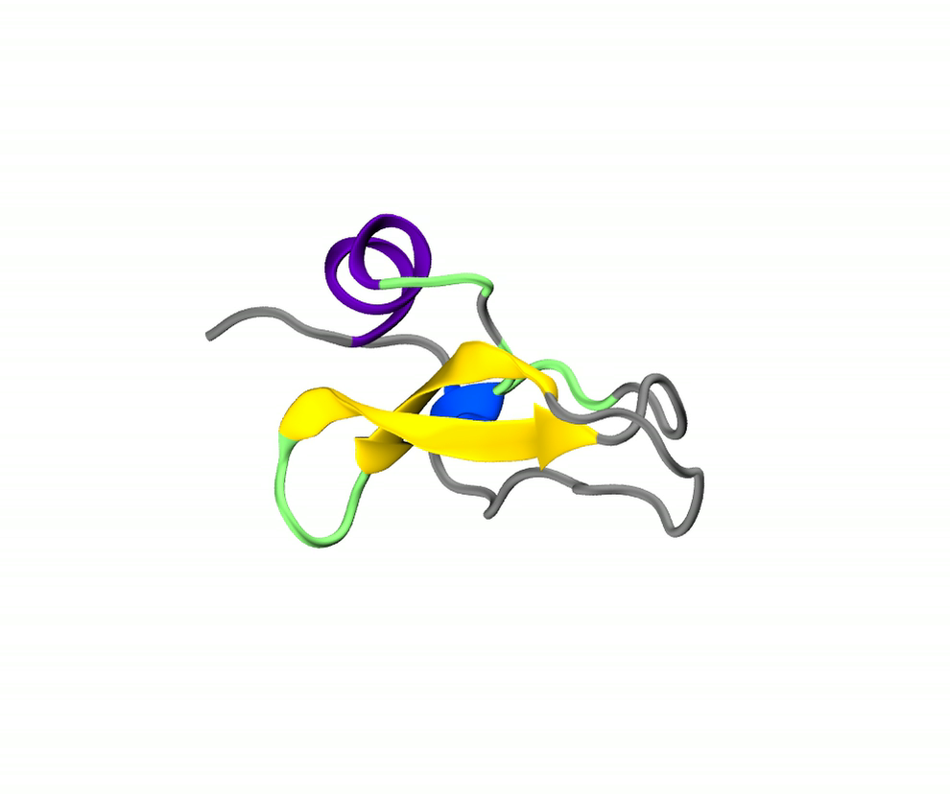
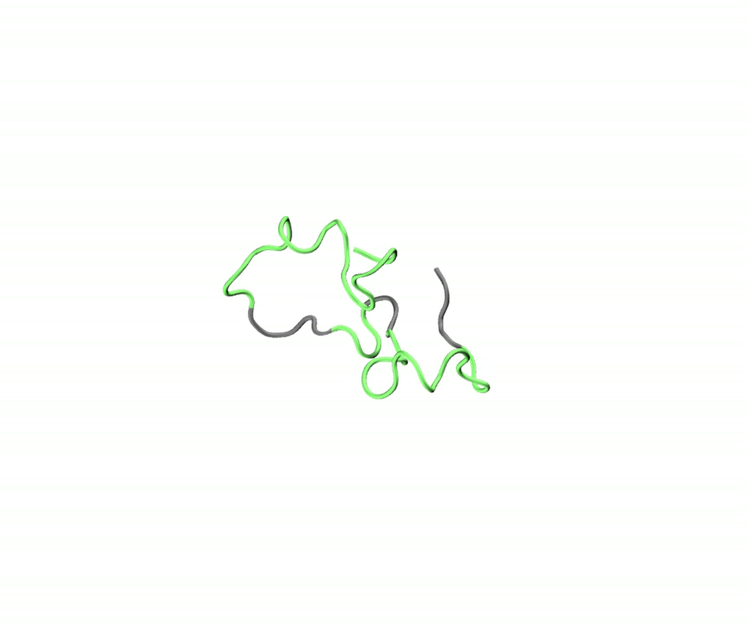
Folded protein dynamics
Disordered protein dynamics

Slide 12
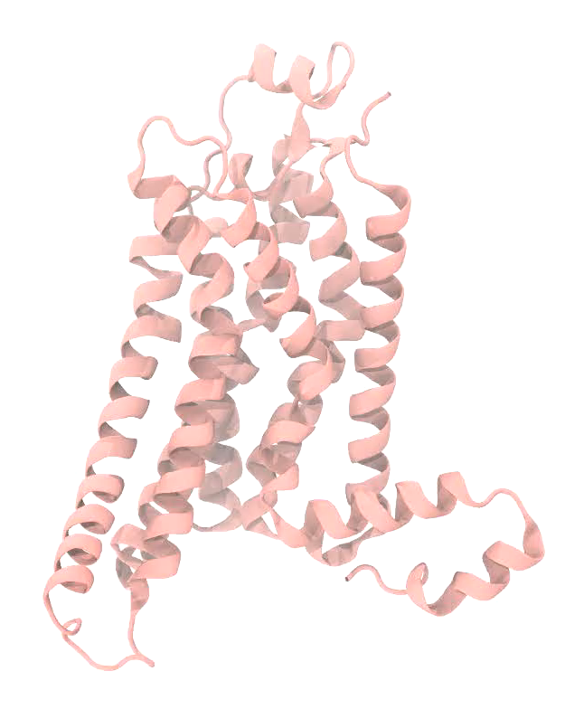
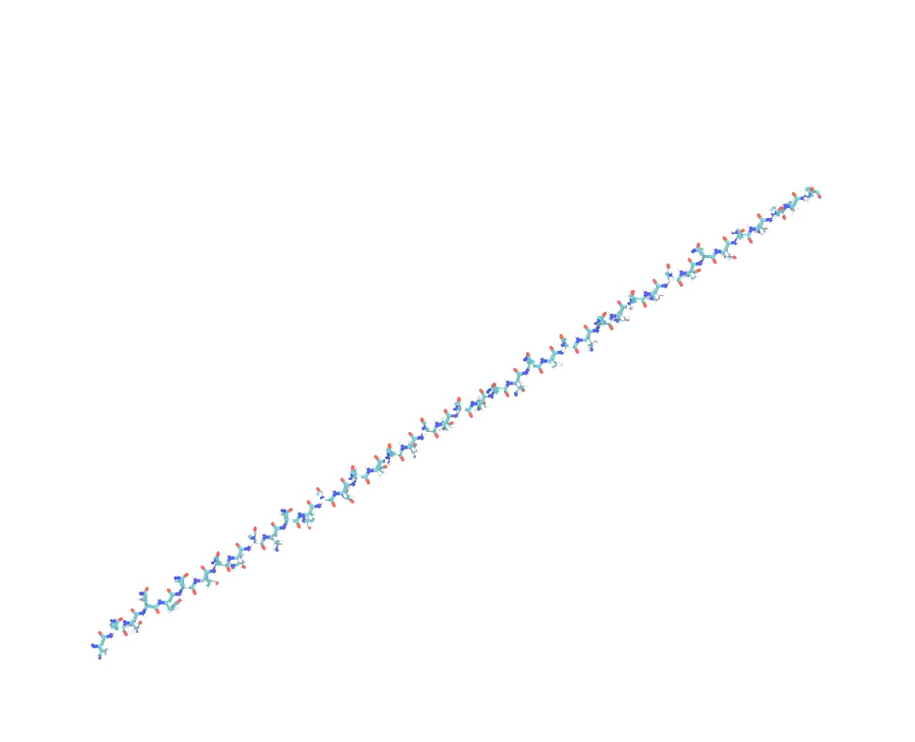
A protein folding
A_{2A} wiggling and jiggling

Slide 13
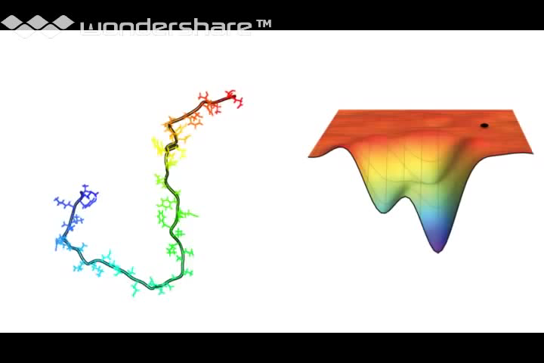
Protein folding is described by an energy landscape

Slide 14
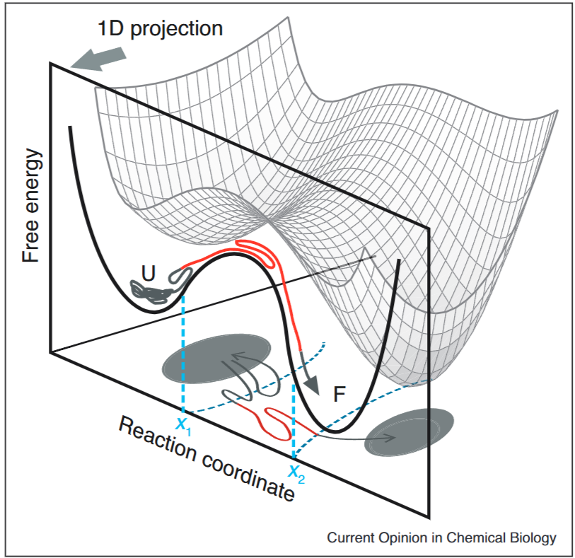
A free energy landscape is a subjective description of a protein’s history
Hoffer and Woodside, Probing microscopic conformational dynamics in folding reactions by measuring transition paths, Current Opinion in Chemical Biology 2019, 53:68–74
Notes:
- Subjective since you must choose rxn coordinate if not working in all-dimensional space

Slide 15
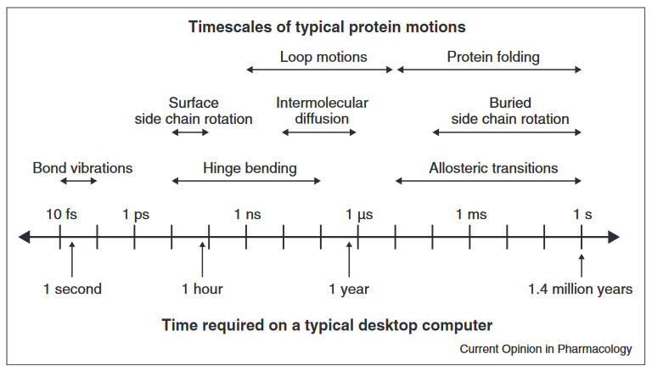
Simulations are expensive – we require the use of ‘supercomputers’
Zwier and Chong, Current Opinion in Pharmacology 2010, 10:745–752
Notes:
There is a balance between:
Money
Complexity of the system (size)
Capability of the computer(s)
This is a bit outdated – if you consider the use of a GPU, you can simulate 1 us of a ~45k atom system in about 4 days (e.g. IL-7_152 on 4070 fatcat)

Slide 16
Our computational microscope enables access to time- and length-scales beyond any experimental methods
With all the information at our fingertips, we become detectives that interrogate the dynamics of proteins and interpret meaning from their complex dances

